Slide 1
COS 711 Guest Lecture
Self-Organising Feature Maps

Slide 2
Overview
The SOM: An Overview
Architecture
Stochastic Training
Batch Map
Growing SOM
Improving Convergence Speed
Map Clustering
Map Visualization
Applications

Slide 3
The SOM: An Overview
Invented by Teuvo Kohonen of the Helsinki University of Technology in 1982
Inspired by the human cerebral cortex
Motor cortex
Somatosensory cortex
Visual cortex
Auditory cortex
Cortices are topologically ordered maps
Form to represent structures sensed in input signals

Slide 4
The SOM: An Overview
Unsupervised learning Neural Network
No explicit target output provided to the network
Instead, finds groupings of items that are intrinsically “similar” to each other
In a general sense, models a data set
Capable of generalisation to cases not presented during training

Slide 5

Architecture
Two-layer architecture:
Layer 1:
Input vector (I-dimensional)
Layer 2:
Two-dimensional ( ) grid of neurons (also know as the map grid)
Weight vectors
I-dimensional
Connect input vector to map grid
One associated with each neuron

Slide 6




Architecture
Definitions:
Training set ( dimensional):
Input vector (I dimensional):
Weight vector (I dimensional):

Slide 7

Architecture

Slide 8
Training: Overall Objective
Operation:
Multidimensional scaling of an I-dimensional input space to an output space of lower dimension (usually 2-dimensional)
Loosely speaking: A approximate compression of input data
Characteristics of the mapping:
Models probability density function of data
Neurons cluster around dense, “similar” areas in the data
Maintains local topological order of data
If 2 patterns are close to one another in I-space, they will be close to one another in SOM output space
Notes:
Compression: Elastic net stretched over a “cloud” of data
Maintains local topological order: Unique

Slide 9

Stochastic Training
Euclidean distance
Between arbitrary vectors V and W

Slide 10
Stochastic Training
The algorithm in a nutshell:
Iteratively present training examples
t represents the current training iteration
A pass through the entire data set is called an epoch
All weight vectors are updated based on each training example
Weight updates are relative to a Best Matching Unit (BMU)

Slide 11

Stochastic Training
In pseudocode:

Slide 12
Stochastic Training
Map initialisation
Weight vectors must be given initial values
Assign random weight values
Values bounded by the range of the corresponding input parameter
Simple to implement
Introduces large variance components
Leads to increased training time

Slide 13
Stochastic Training
Map initialisation
For each weight vector
Select a random input pattern
Initialise the weights using corresponding input parameter values
Often leads to premature convergence
Perturb weights with small random values

Slide 14
Stochastic Training
Map initialisation
Find the 1st two principal eigenvectors of
The two mutually orthogonal vectors that account for the most variability in the data
Initialise weight vectors
In an orderly fashion along a 2D subspace
The subspace is spanned by the eigenvectors

Slide 15
Stochastic Training
Map initialisation
Hypercube initialisation
Weight vectors defined to form a hypercube covering all the training patterns
Find two patterns with largest inter-pattern Euclidean distance
Find third pattern furthest from the first two
Find fourth pattern furthest from the first three
These four patterns become the weight vectors of the four corner neurons of the map
The remaining weight values are interpolated from the corner weight values

Slide 16
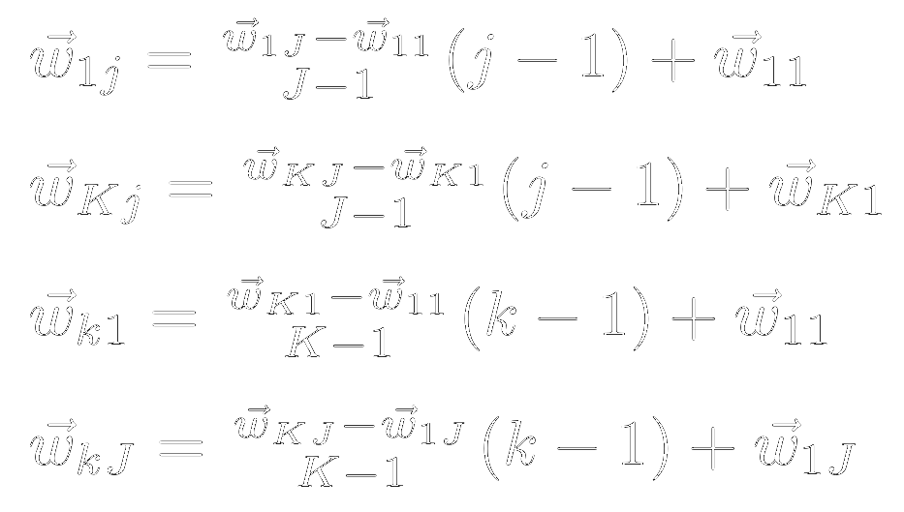
Stochastic Training
Map initialisation
Hypercube initialisation
Initialise weights of boundary neurons:

Slide 17

Stochastic Training
Map initialisation
Hypercube initialisation
Initialise remaining weights:

Slide 18
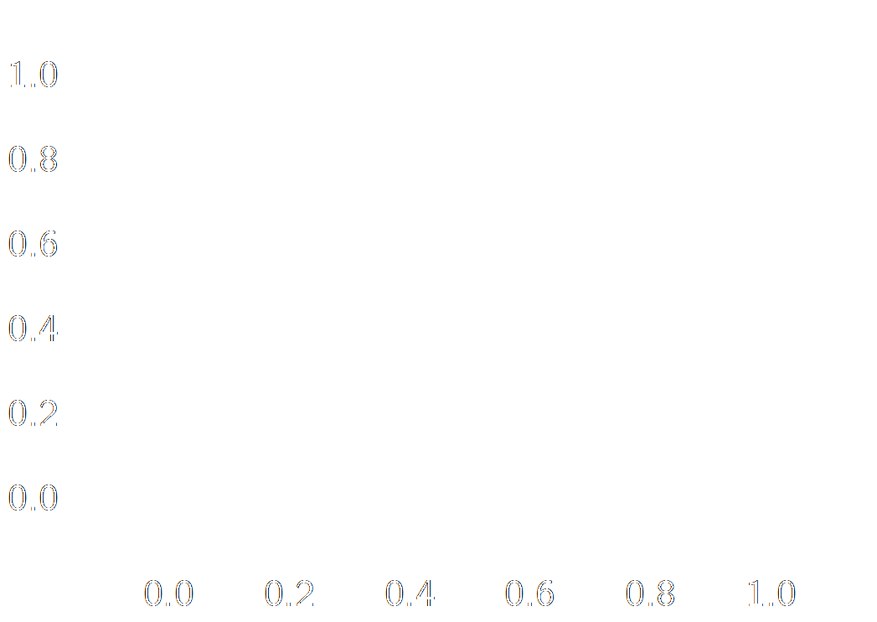
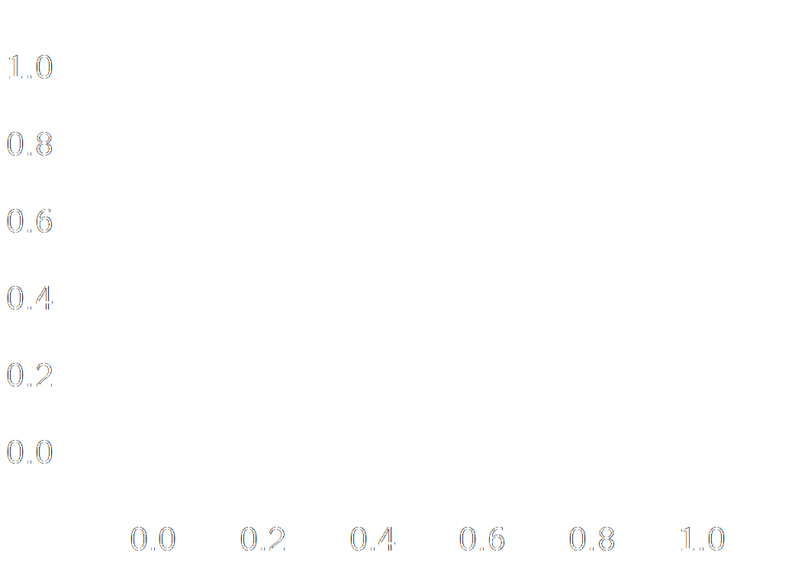
Stochastic Training
Map initialisation
Random versus hypercube initialisation

Slide 19

Stochastic Training
Find the BMU
Weight vector mn
The one closest to the current training pattern

Slide 20


Stochastic Training
Update weight vector:
Moves the weight vector of the current BMU, as well as its neighbours, closer to the current training pattern

Slide 21
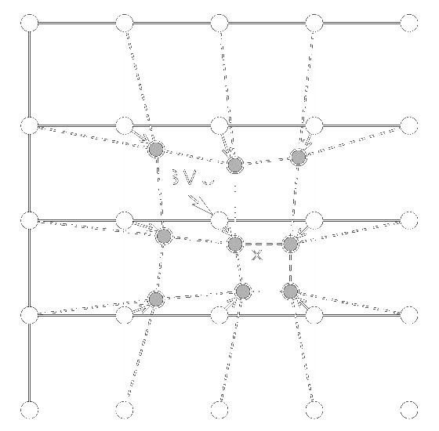
Stochastic Training
Adapted from: Olli Simula, Petri Vasara, Juha Vesanto, and Riina-Riitta Helminen. The Self-Organizing Map in industry analysis. In Industrial Applications of Neural Networks, chapter 4, pages 87–112. CRC Press, 1999.

Slide 22




Stochastic Training
Neighbourhood function
Smooth Gaussian kernel:
Components:
= Distance between map co-ordinates
of BMU mn and weight vector kj
= Learning rate
(determines kernel height)
= Neighbourhood radius
(determines kernel width)

Slide 23

Stochastic Training
A Gaussian kernel

Slide 24



Stochastic Training
Standard Gaussian
kernel
Kernel with reduced
learning rate
Kernel with reduced
neighbourhood radius

Slide 25


Stochastic Training
Both learning rate and neighbourhood radius should be
Monotonically decreasing functions of t
i.e. they decrease as training progresses
For example:
Notes:
Larger tau1 and tau2 result in slower decays

Slide 26

Stochastic Training

Slide 27
Stochastic Training
Stopping conditions
At least one must be tested every iteration
Simplest option
Limit on training iterations (t)
Problems?

Slide 28

Stochastic Training
Stopping conditions:
Training error (quantisation error):
User-selected minimal level
Test for convergence in error:
Fluctuations necessitate using a window
Decrease since previous iteration (moving average)
Standard deviation

Slide 29

Stochastic Training

Slide 30

Stochastic Training

Slide 31

Stochastic Training
Stopping conditions:
Average component weight change
Decreases to a minimal level close to 0

Slide 32
Batch Map
Initialise weight vectors by assigning the first K×J training patterns to them
while stopping conditions are not met do
for each neuron, kj do
Collect a list of all patterns in the neighbourhood of neuron kj
end for
for each weight vector do
Set the weight vector to the mean over the list of patterns for the
weight vector’s neuron
end for
end while
Notes:
Attributed to Kohonen

Slide 33




Fast Batch SOM
Initialise weight vectors using any initialisation approach
while stopping conditions are not met do
for each neuron, kj do
Collect a list of all patterns whose BMU is neuron kj
Compute the mean over this list of patterns
end for
for each weight vector do
where is the number of patterns for which neuron nm is the winner
end for
end while
Notes:
Attributed to Kaski in Prof Engelbrecht’s textbook, but actually originally proposed by Kohonen

Slide 34
Growing SOM
To find an optimal SOM architecture
Start training with a small map
Grow map as more neurons are required
A growing condition is tested each iteration
If growing is triggered
Find the neuron, kj, with the largest quantisation error
Find neighbour in row dimension furthest from kj
Insert a row between the two
Find neighbour in column dimension furthest from kj
Insert a column between the two

Slide 35
Shortcut Winner Search
Reduce computational cost of BMU search
Assume that a pattern’s BMU is in the vicinity of the pattern’s BMU for the previous epoch
Calculate the distance between the pattern and the previous BMU
Calculate the distance between the pattern and the neighbours of the previous BMU
If the previous BMU is still the best match, use it
Else, use neighbour that is the closest to the pattern

Slide 36
Map Clustering
Non-emergent Feature Maps:
Each neuron represents a single cluster of training patterns
Similar to k-means clustering
Emergent Feature Maps:
Clusters of neurons form
Different (emergent) behaviour to standard clustering approaches (or a non-emergent feature map)

Slide 37
Map Clustering
Emergent feature maps offer advantages, but the clusters of weight vectors still need to be discovered
Use a standard clustering algorithm on the map’s weight vectors:
Hierarchical clustering algorithm:
e.g. Ward clustering
Partitional clustering algorithm:
e.g. k-means clustering

Slide 38
Map Visualisation
Recall that:
A SOM produces a map that approximates the distribution of its training data
The map is defined by its weight vectors
This means that:
A representation of the map is equivalent to an approximate representation of the data
Most visualisation techniques are displays of the weight vectors

Slide 39
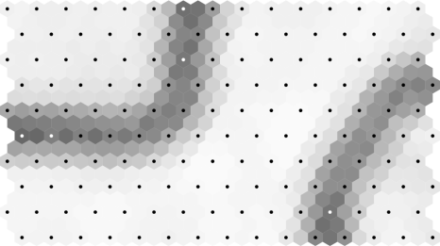
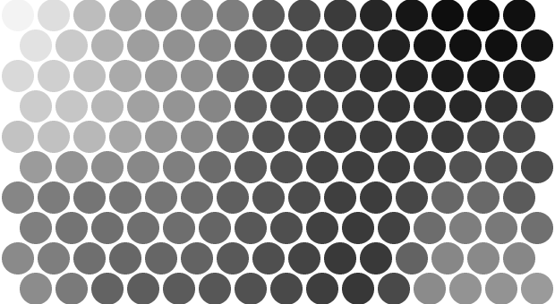
Map Visualisation
There are many map visualisation techniques
The most commonly used
U-matrix
Visualises distances between weight vectors
Shows us the cluster structures of a map
Component planes
Visualise one weight across the map
Shows us the nature of the data distribution

